Slide 1
Parallel and Concurrent Programming in Haskell
Krzysztof Gogolewski
Monadic Warsaw, 25.08.2015

Slide 2
Parallel and concurrent
In a parallel program, we want to use several CPUs to compute faster
In a concurrent program, we want to make sure that independent running interactions are handled properly

Slide 3
New threads
forkIO :: IO () -> IO ThreadId
in Control.Concurrent is all it takes to run a program in a new lightweight Haskell thread.
See Fork1.hs and Remind.hs.
How to stop a thread?

Slide 4
Cancelling threads
throwTo :: Exception e =>
ThreadId -> e -> IO ()
killThread :: ThreadId -> IO ()
See Fork2.hs and Fork3.hs.
Exceptions complicate a lot.

Slide 5
Communication between threads
By default, everything is immutable
To have mutable variables, use a library

Slide 6
IORef
newIORef :: a -> IO (IORef a)
readIORef :: IORef a -> IO a
writeIORef :: IORef a -> a -> IO ()
modifyIORef :: IORef a ->
(a -> a) -> IO ()

Slide 7
Different notions of variables
Possibly empty (MVar)
Write-once (IVar)
Transactional (TVar)
Bound to a block (STRef)
Limited to values storable in GPU (Accelerate)
IORef is very fast.

Slide 8
MVars
newEmptyMVar :: IO (MVar a)
takeMVar :: MVar a -> IO a
putMVar :: MVar a -> a -> IO ()
MVars are primitive and can be used to bulid concurrent data structures.
MVars are fair.
See MVar1.hs and MVar2.hs

Slide 9
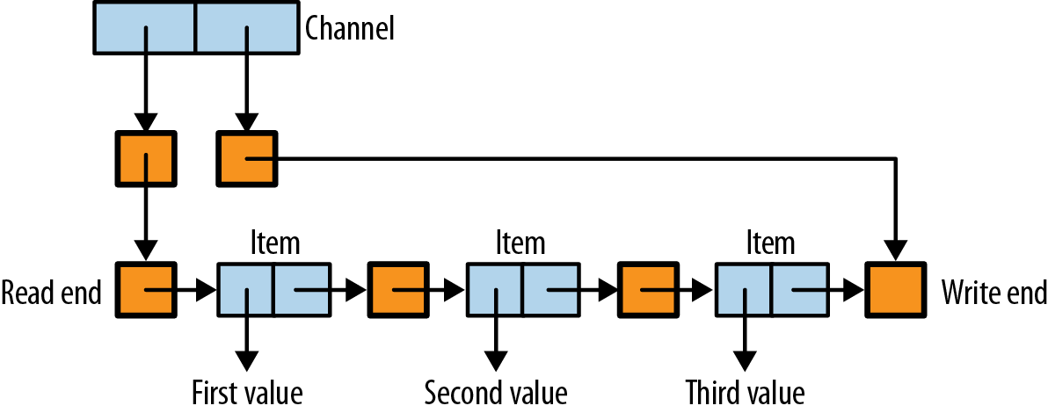
A normal list:
data List a = Nil | Cons a (List a)
A channel (simplified):
data Chan a = Nil | Cons a (MVar (List a))
See Chan.hs

Slide 10
A bank
We'd like to have N accounts, remember amount on each of them and allow transfers
How to lock? One option would be a MVar containing the mapping account -> amount.

Slide 11
A bank – part 2
First attempt:
transfer a b n = do
modifyMVar_ a (subtract n)
modifyMVar_ b (+n)

Slide 12
A bank – part 3
Another option is
transfer a b n = do
a' <- takeMVar a
b' <- takeMVar b
putMVar a (a' – n)
putMVar b (b' + n)

Slide 13
Transactional variables
newTVar :: a -> STM (IORef a)
readTVar :: TVar a -> STM a
writeTVar :: TVar a -> a -> STM ()
modifyTVar :: TVar a ->
(a -> a) -> STM ()
atomically :: STM a -> IO a
See Bank1.hs and Bank2.hs

Slide 14
Async
cabal install async
async :: IO a -> IO (Async a)
wait :: Async a -> IO a
cancel :: Async a -> IO ()
waitEither :: Async a -> Async b -> IO (Either a b)
waitBoth :: Async a -> Async b -> IO (a,b)
withAsync :: IO a ->
(Async a -> IO b) -> IO b

Slide 15
mapConcurrently ::
(a -> IO b) -> [a] -> IO [b]
race ::
IO a -> IO b -> IO (Either a b)
concurrently ::
IO a -> IO b -> IO (a,b)
newtype Concurrently a =
Concurrently (IO a)
instance Applicative Concurrently

Slide 16
Parallel – what I have not talked about
Control.Monad.Par: IVar, deterministic parallelism
Laziness and evaluation stragies
par :: a -> b -> b
No deadlocks and always deterministic.

Slide 17
For more
“Parallel and Concurrent Programming in Haskell” by Simon Marlow
http://chimera.labs.oreilly.com/books/1230000000929
https://github.com/simonmar/parconc-examples

